Slide 1
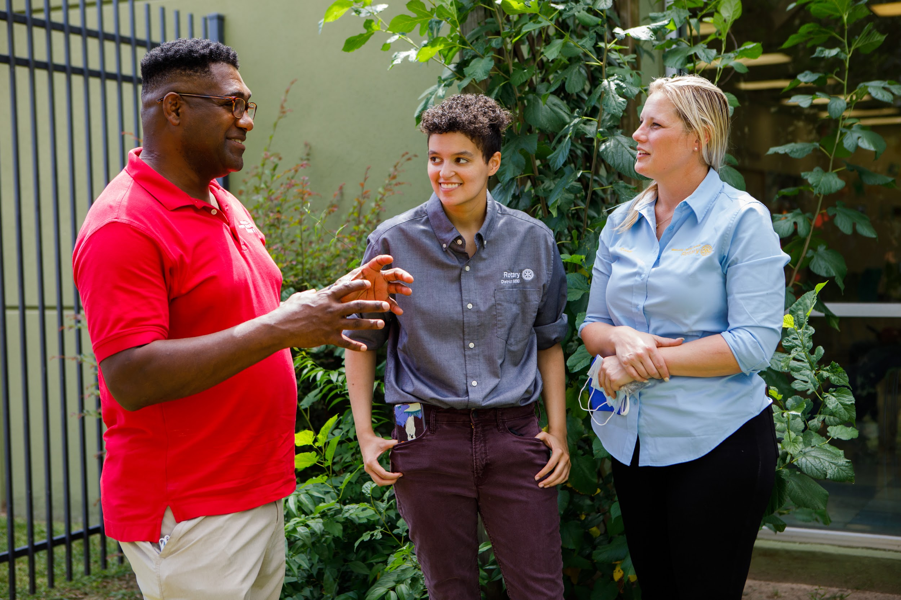

3 ACTIONS TO IMPACT
YOUR PUBLIC IMAGE TODAY
Title Page Option

Slide 2
MAKE FRIENDS WITH THE LEARNING CENTER & BRAND CENTER

Slide 3

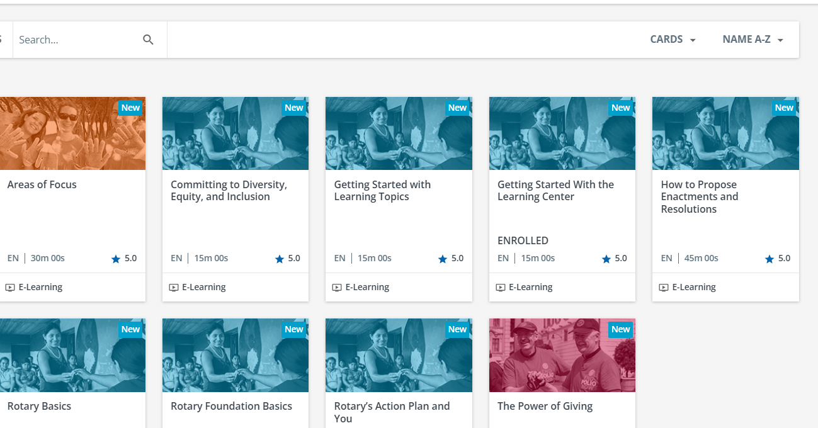
THE LEARNING CENTER
Expand Your Knowledge
Prepares you for leadership and committee roles
Helps solve problems
You choose the topics and when to learn
Courses are practical and short
Notes:
Online resource, available for free at My Rotary @Rotary.org. Start a new Rotary year, new job, may be presented with a challenge or question.///on demand 24/7 like streaming favorite TV show or podcast///short courses for busy lives.

Slide 4
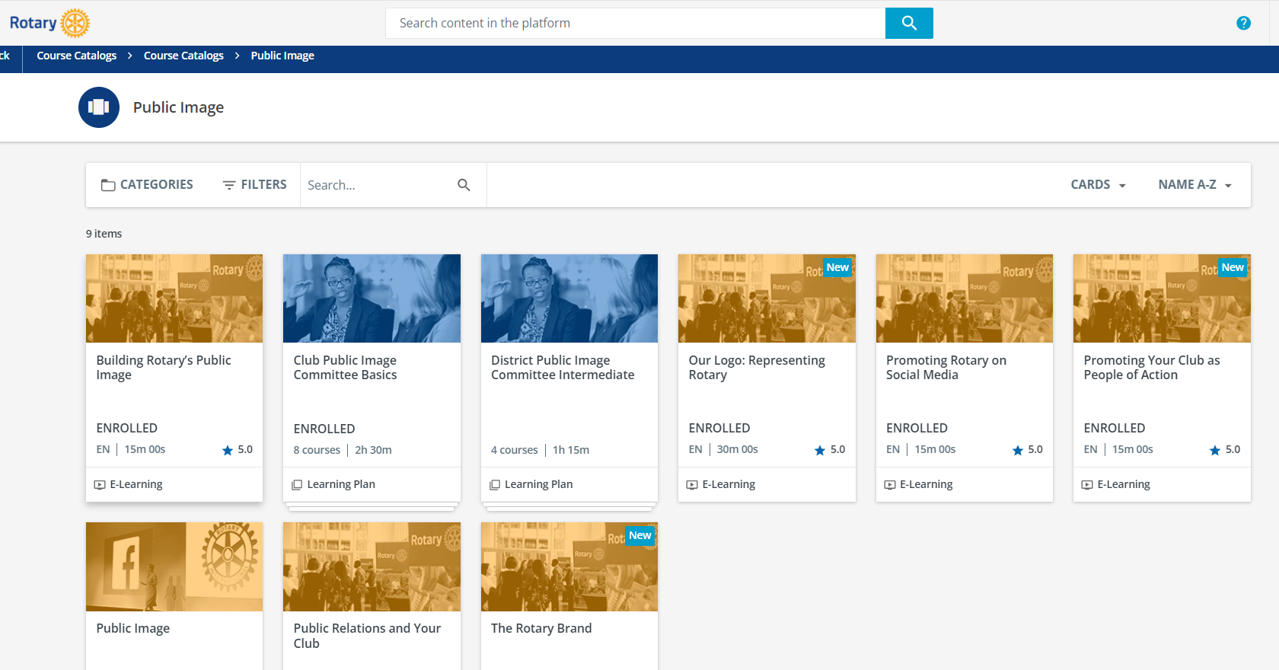
INCLUDES GOOD PUBLIC IMAGE INFO
Notes:
You’re here for Public Image so start with a good number of very relevant helpful topics. Social Media. Websites, PR.

Slide 5
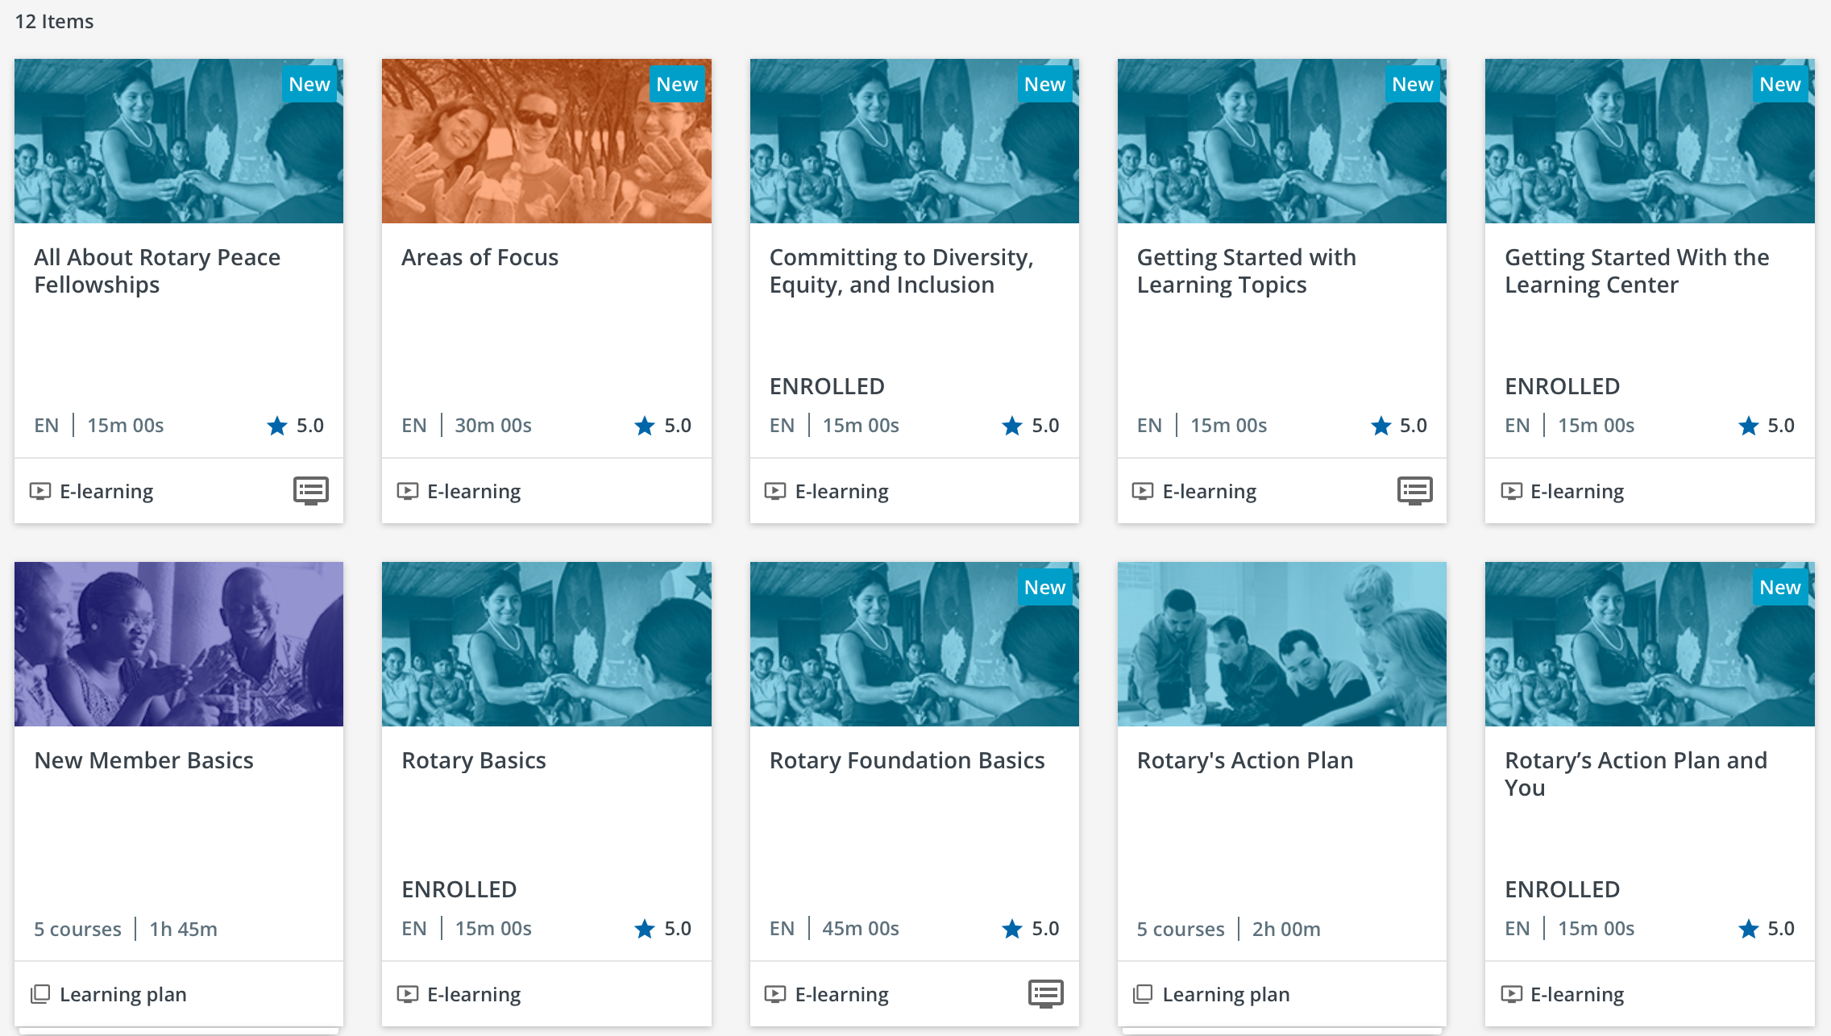
VARIETY OF TOPICS: ROTARY LIFE
Notes:
We are all ROtary ambassadors. Youll make a more positive impression, the more you know about our organization so explore things like Rotary Basics, Foundation, OTHER valuable info to help you speak more comfortably and confidently.

Slide 6
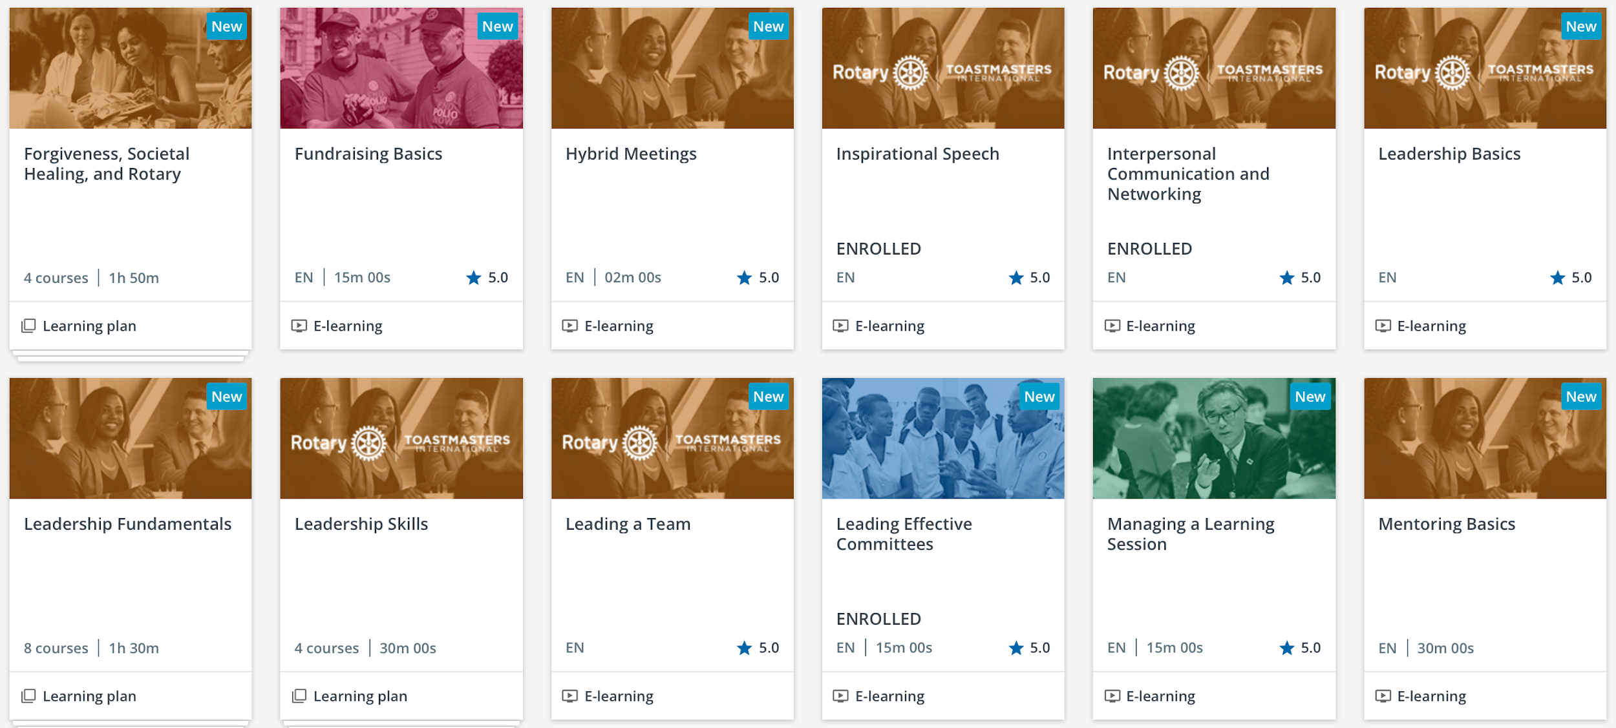
PROFESSIONAL LIFE
Notes:
Leadership Mentoring, Communication, speeches, toastmasters. SUGGESTION: Make Learning Center a part of your meeting program. Actually go through a course so all can learn together and members can see how easy and valuable it is.

Slide 7
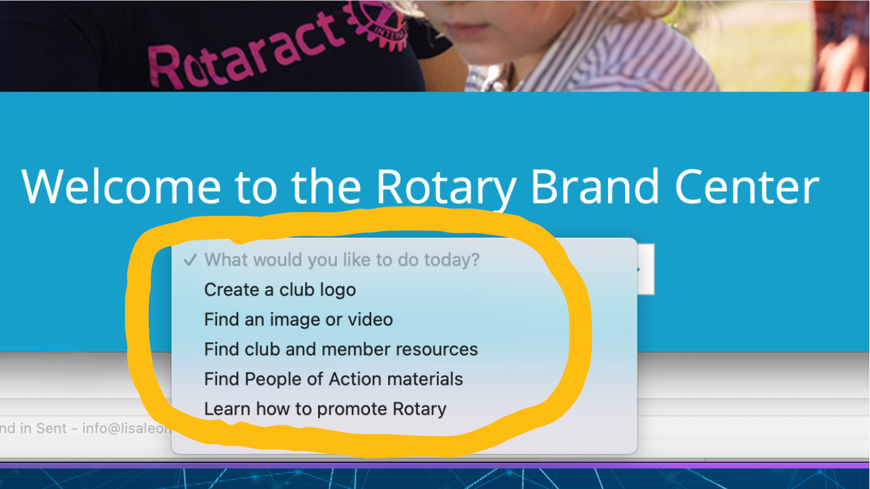
THE BRAND CENTER
Always There to Help You

Slide 8
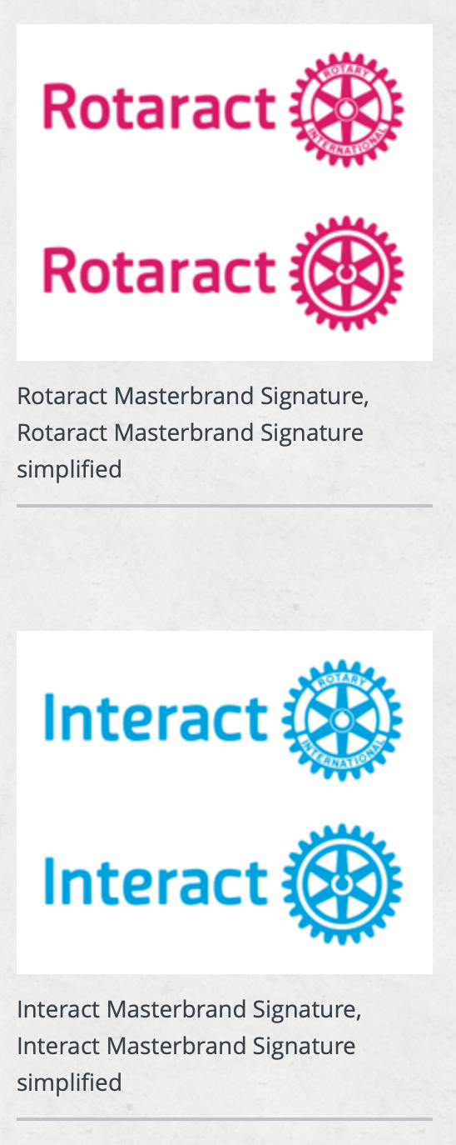
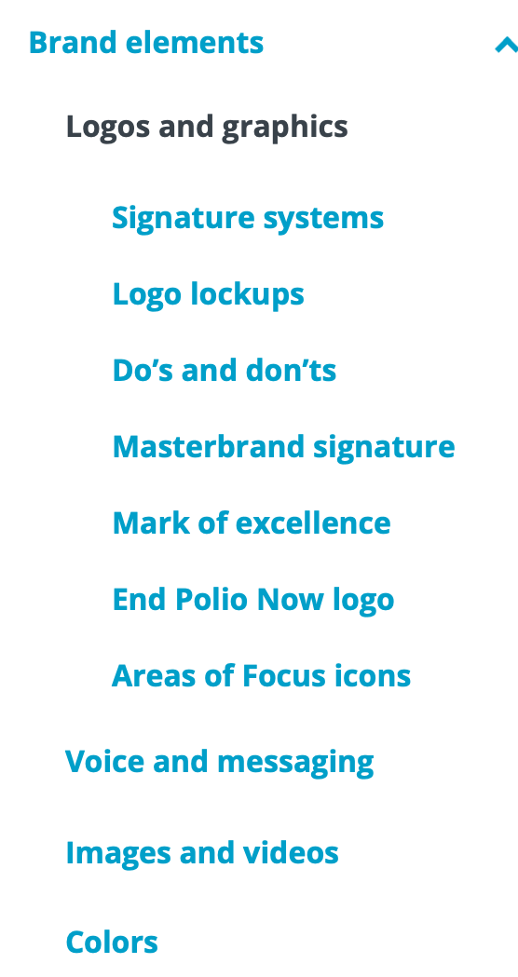


LOGOS

Slide 9

PHOTOS AND VIDEOS

Slide 10
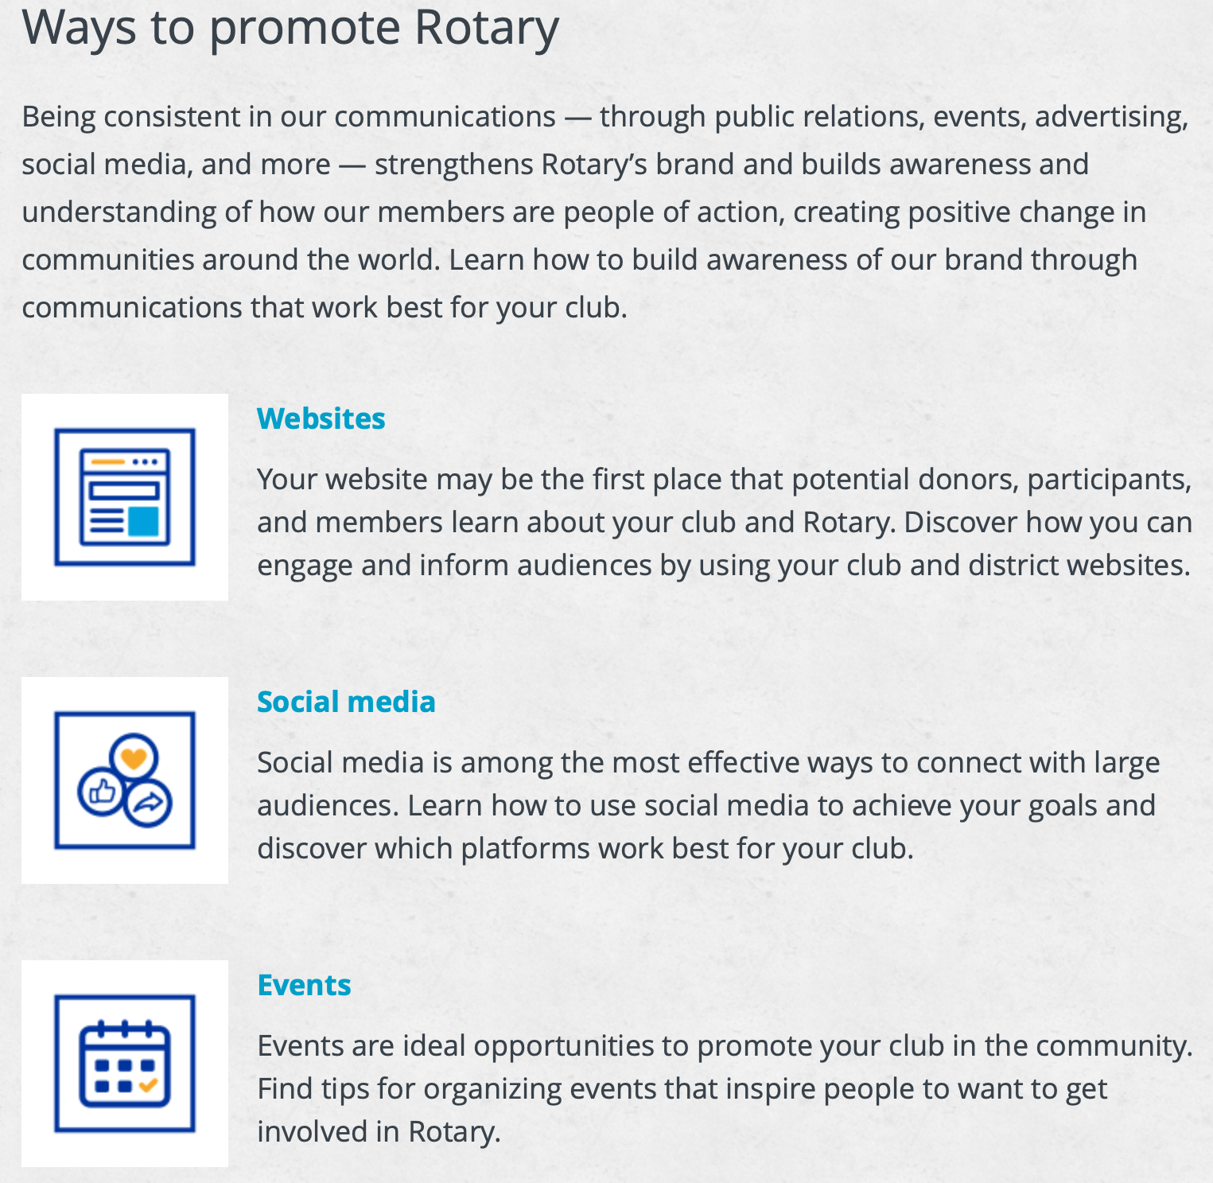
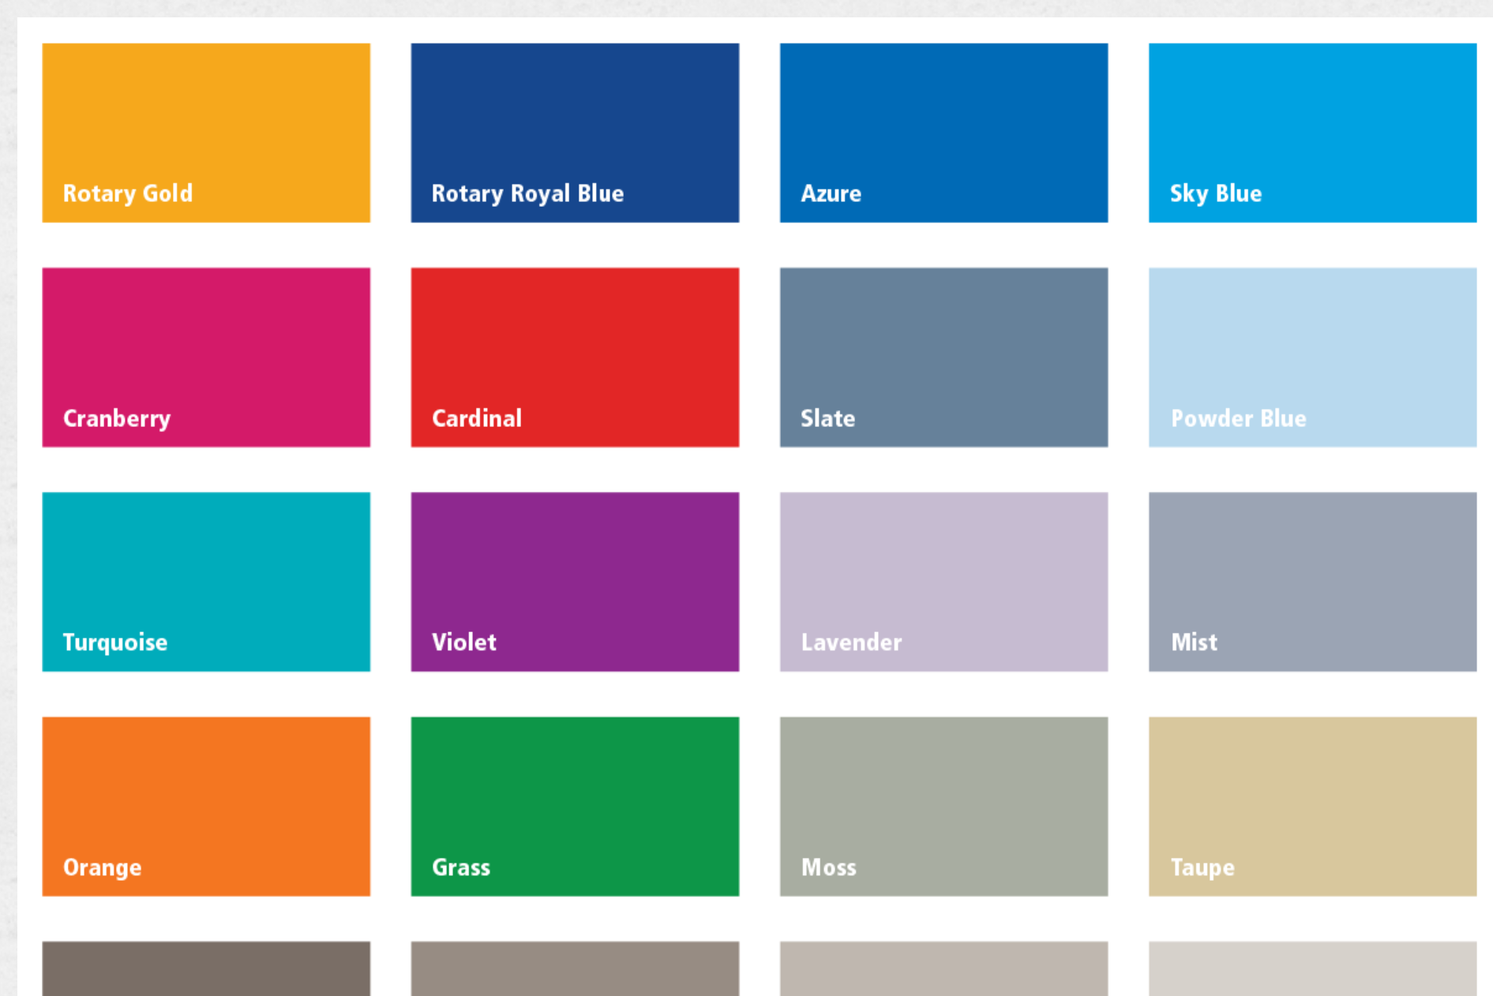
OTHER TOOLS
Colors and Fonts

Slide 11

WHY USE THE BRAND CENTER?
It will help you create powerful, compelling messages
Strengthens our brand and looks professional
Highlights People of Action as a way of talking about us
Keeps communications consistent
Engages and attracts more members, partners, and donors

Slide 12

BOOKMARK IT!
BRANDCENTER.ROTARY.ORG

Slide 13
2. LEVERAGE COMMUNITY CONNECTIONS

Slide 14
What we will cover:
Media connections
Building relationships + engaging with local leaders
Be the brand
Understanding your community + volunteer and member engagement
LEVERAGE COMMUNITY CONNECTIONS

Slide 15

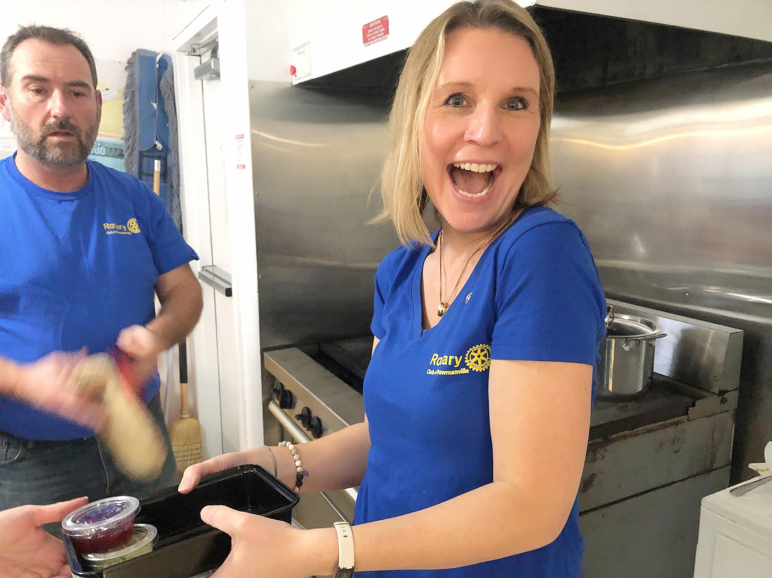
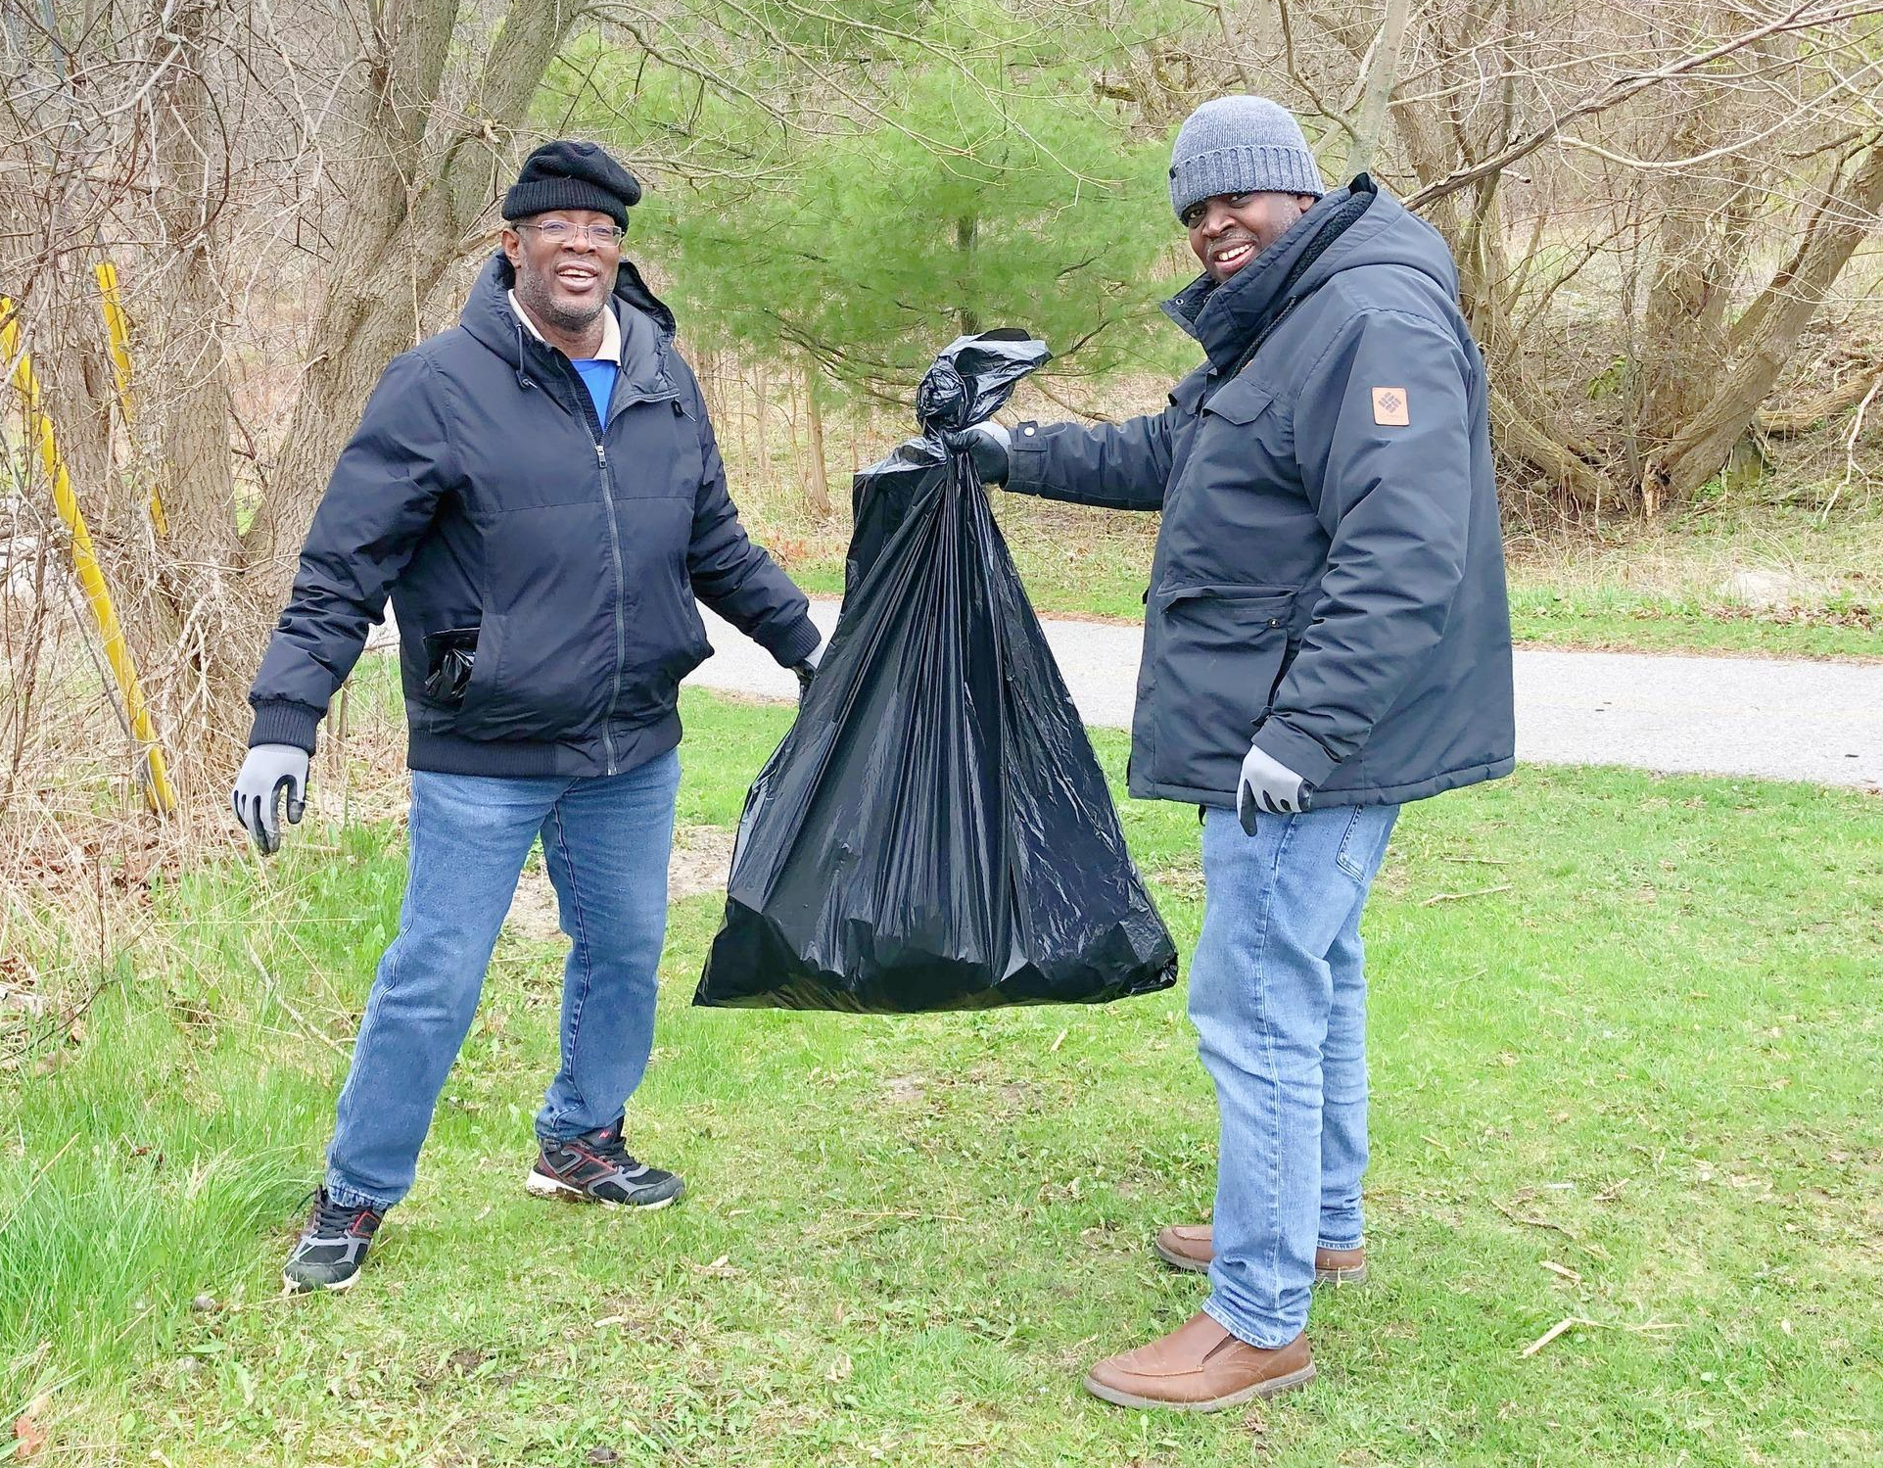
MEDIA CONNECTIONS
Selling your story…
Perception is reality…

Slide 16


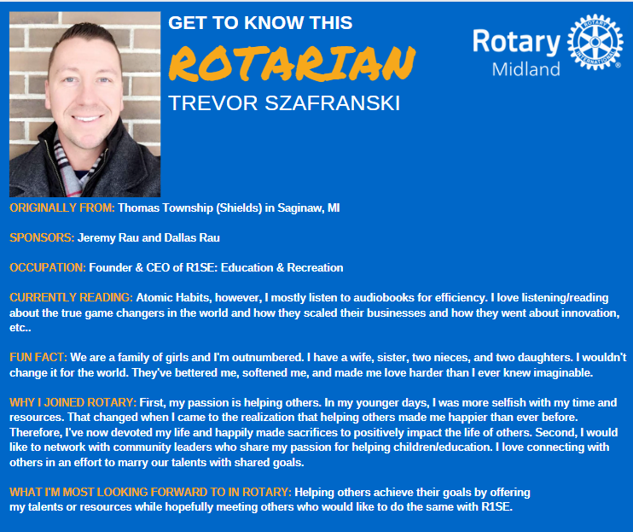
LEVERAGE COMMUNITY CONNECTIONS
Building Relationships + Engaging with Local Leaders
- Community Leaders -
- Community Events -
- Your Network -

Slide 17
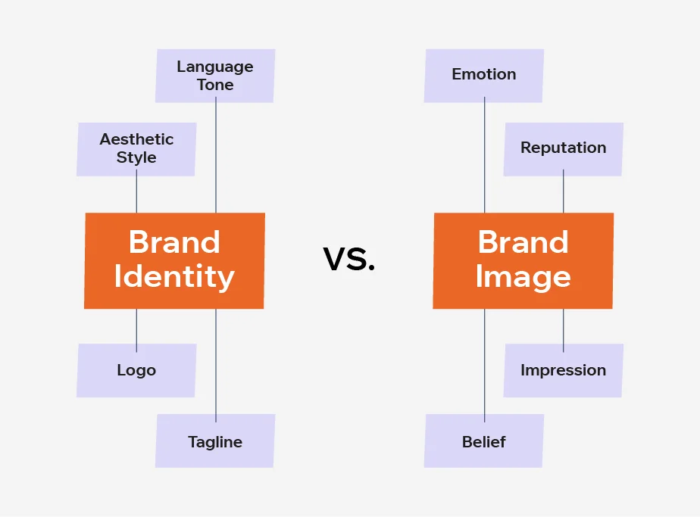


LEVERAGE COMMUNITY CONNECTIONS
Be the Brand
When you partner with someone in the community, you are your own brand and doing your own public image.
Wear your t-shirt, pin, hat, etc. That is your opportunity to showcase who Rotary is and share your story.
Notes:
When you partner with someone in the community, you are your own brand and doing your own public
image.
Wear your t-shirt, pin, hat, etc. That is your opportunity to showcase who Rotary is and share your story.

Slide 18

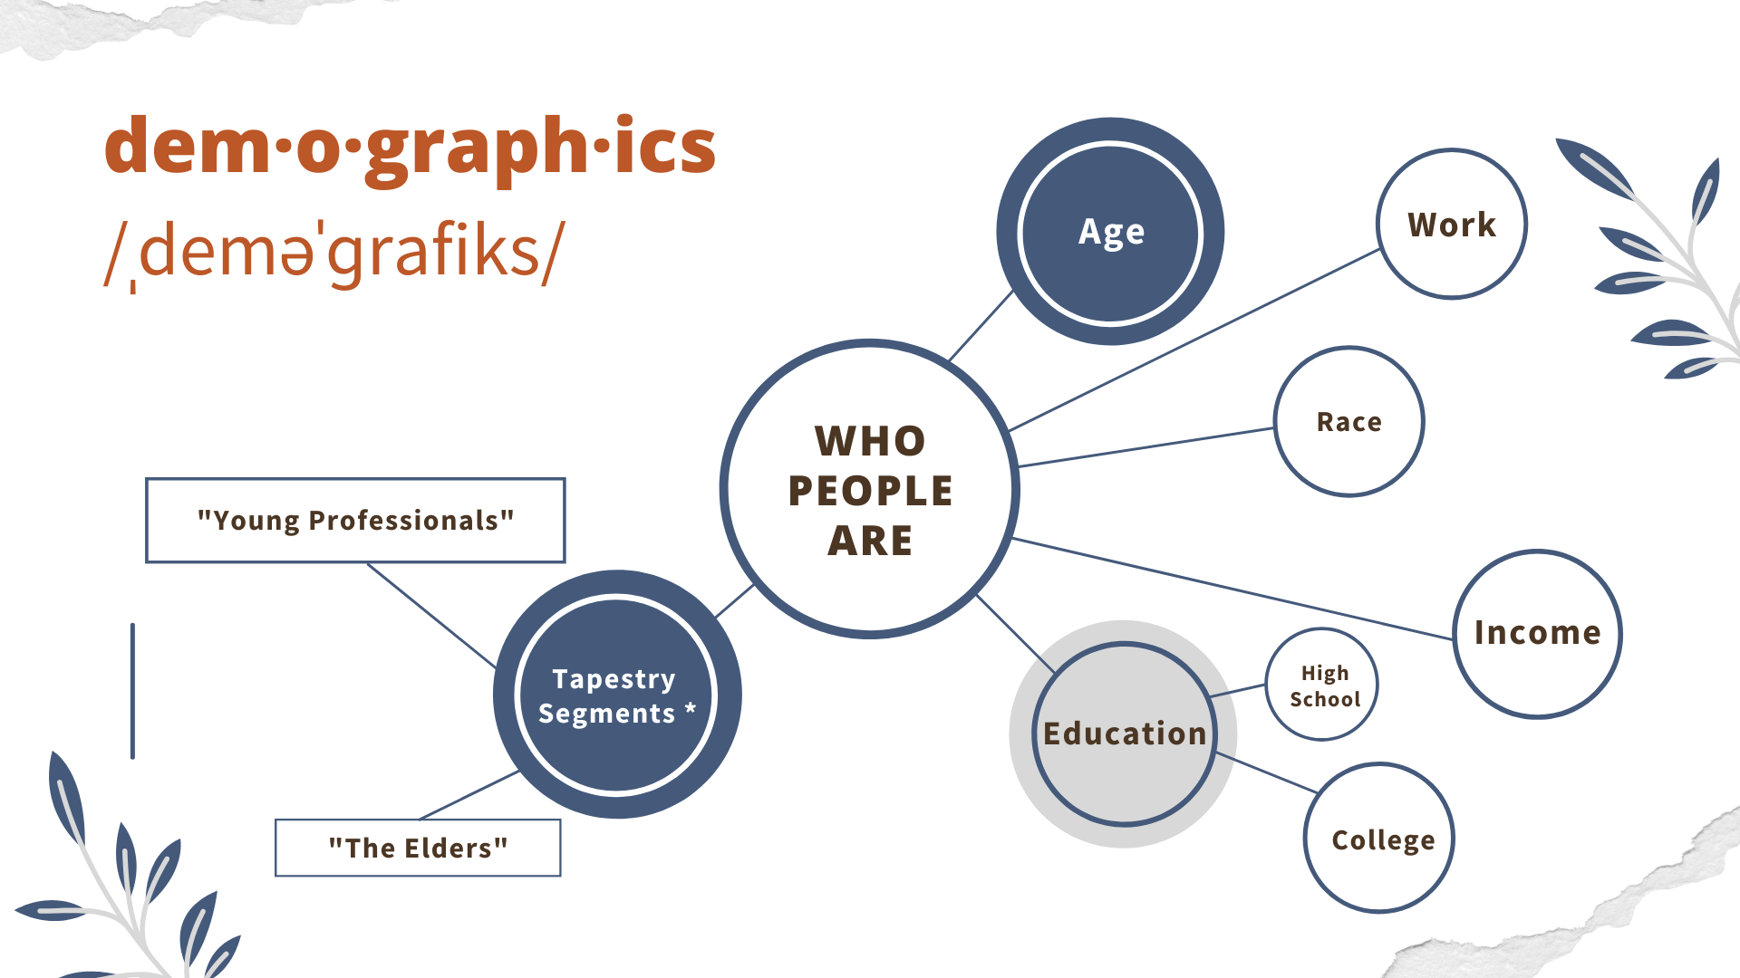

LEVERAGE COMMUNITY CONNECTIONS
Understanding Your Community + Volunteer and Member Engagement
Know your customer in and out
Motivate members/volunteers to get comfortable talking about Rotary
Spotlight what matters to these internal stakeholders, including how awesome they are
Notes:
Importance of knowing your community demographics and needs (use local data to tailor the approach)
Various methods for understanding your community: Polls, surveys, focus groups etc
Use local data and resources to tailor your approach.
Importance of engaging your volunteers and members.
Strategies for involving them in community outreach and public image efforts.
Recognizing and celebrating their contributions.

Slide 19
LEVERAGE COMMUNITY CONNECTIONS
Conclusion
Your Rotary story is powerful and can be an invitation to media and potential members.
Leverage leaders in your club, community, and your network!
Wearing Rotary swag in your community is a great way to build the brand—and Rotary membership!
People you connect with in your Rotary club are catalysts for the exposure and access to new members, money, and momentum for your projects. KYC (Know Your Customer) still applies.
Notes:
PLEASE SKIP THIS SLIDE - GROUP HAS DECIDED/D. Rau

Slide 20
3. EXPAND YOUR DIGITAL PRESENCE

Slide 21
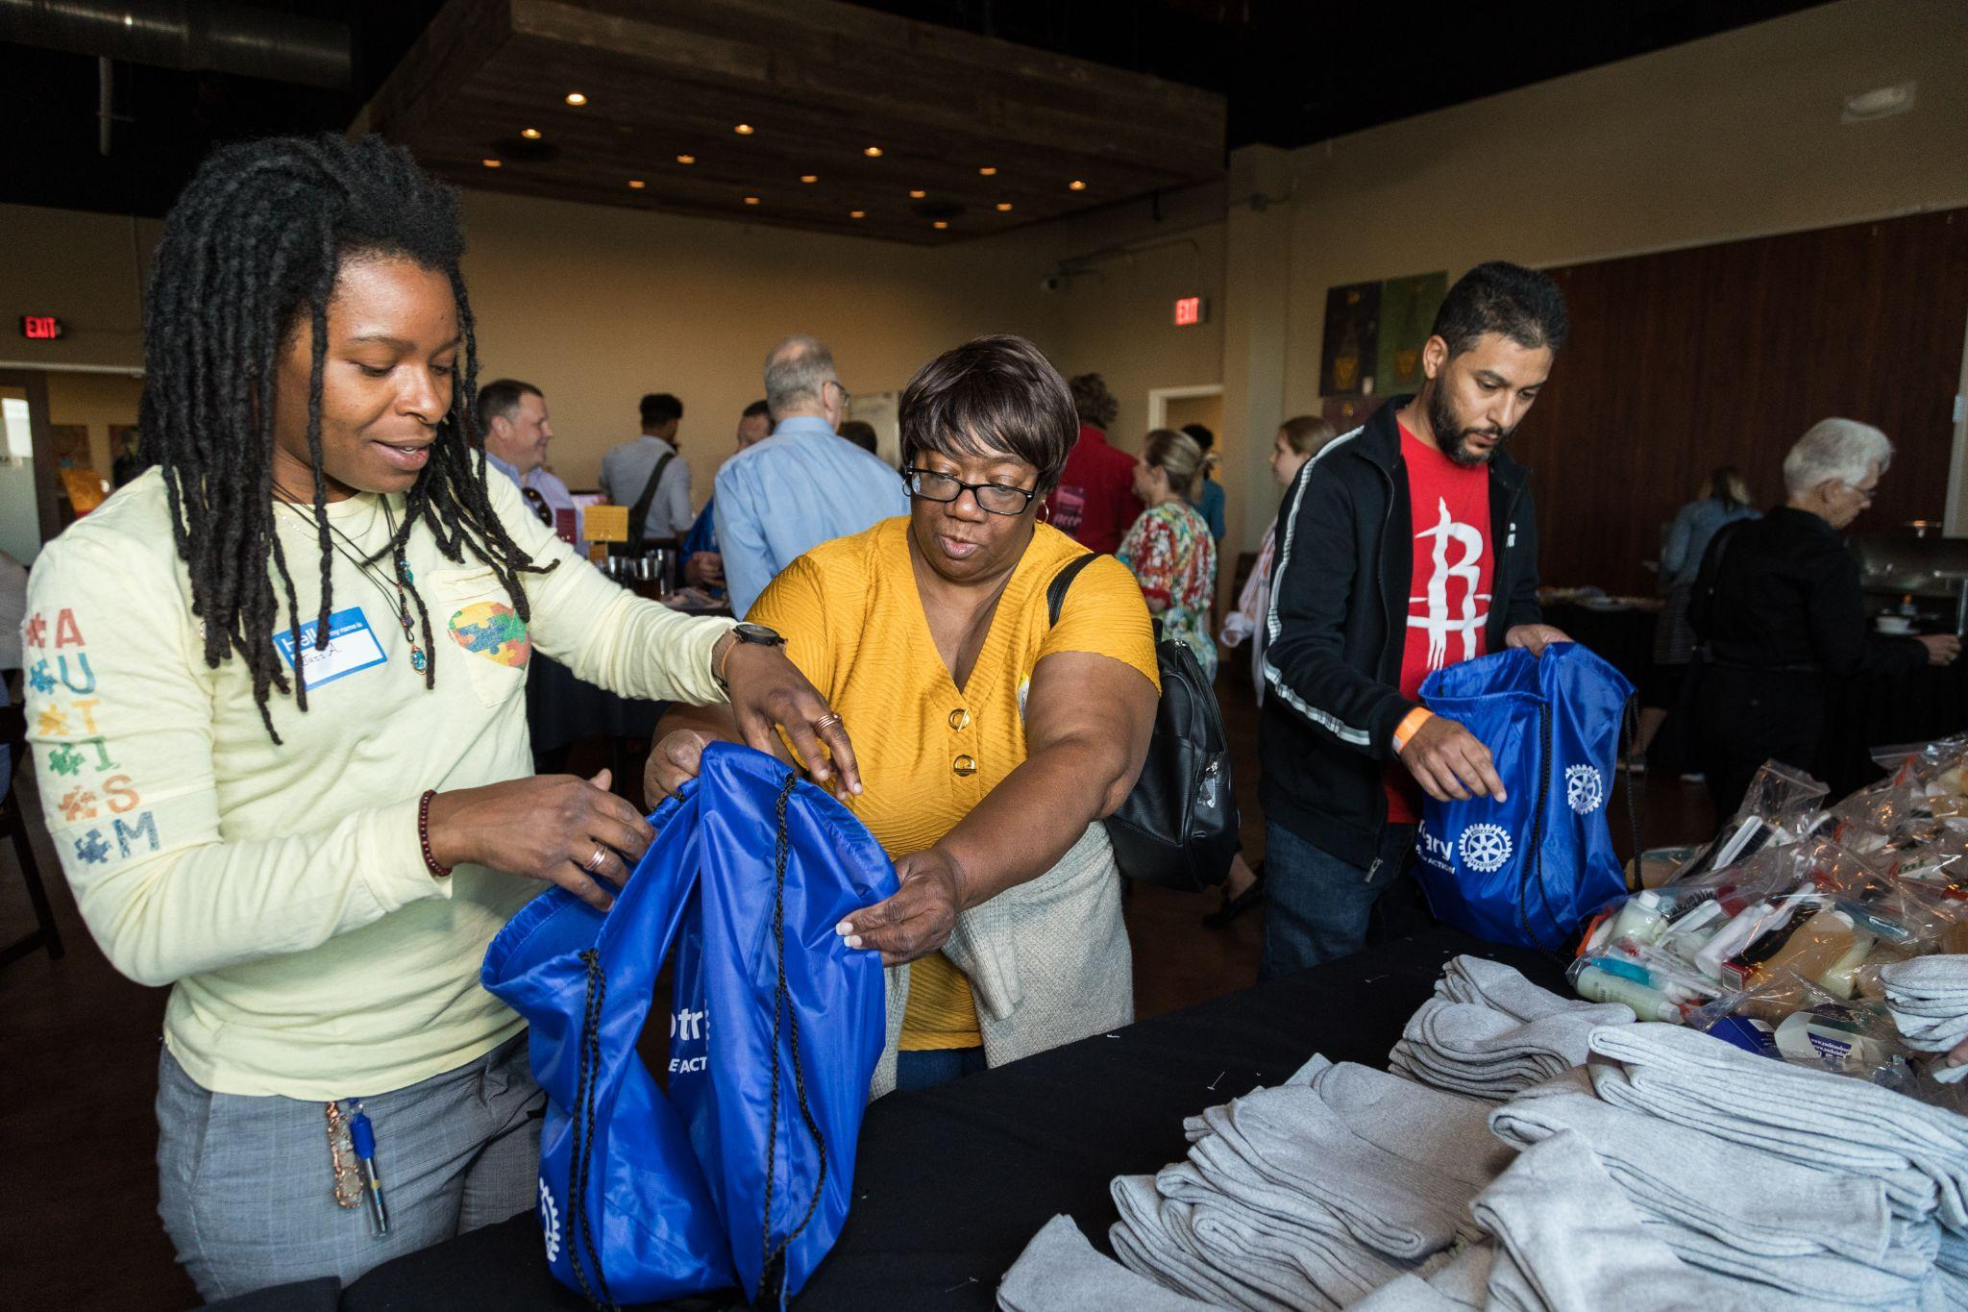
WHAT IS DIGITAL PRESENCE?
You can exist online, but it does not mean having a presence
email
Website
Social Media
Facebook
Instagram
LinkedIn
X (Twitter)
You, Rotary clubs, Rotary district: storytelling
The Internet = The ‘traffic’ you create online
Website to social media to website
The Public = How people perceive your online Rotary presence
What they say about you
How they engage with you
Rotary Leadership Colors
Royal Blue
R23,G69,B143
Azure
R0,G93,B170
Sky Blue
R1,G180,B231
Gold
R247,G168,B27
Secondary Colors
Cranberry
R217,G27, B92
Turquoise
R0,G153,B153
Violet
R135,G33,B117
Orange
R255,G118,B0

Slide 22

EXPAND YOUR DIGITAL PRESENCE
Storytelling: Visibility, credibility, reputation
The actions you take and the content you produce:
What makes you different?
Understand what makes a meaningful story
Impact your audience emotionally, mentally, and even physically
Rotary Leadership Colors
Royal Blue
R23,G69,B143
Azure
R0,G93,B170
Sky Blue
R1,G180,B231
Gold
R247,G168,B27
Secondary Colors
Cranberry
R217,G27, B92
Turquoise
R0,G153,B153
Violet
R135,G33,B117
Orange
R255,G118,B0
Notes:
Storytelling
Visibility, Credibility, Reputation
The actions you take and the content you produce
What makes you different?
Focus on relevance
Understand what makes a meaningful story.
Who – What – Where – When – Why
Impact your audience emotionally, mentally and even physically
Evoke pride, empathy, joy
Compel readers to act – donate, participate, join Rotary

Slide 23
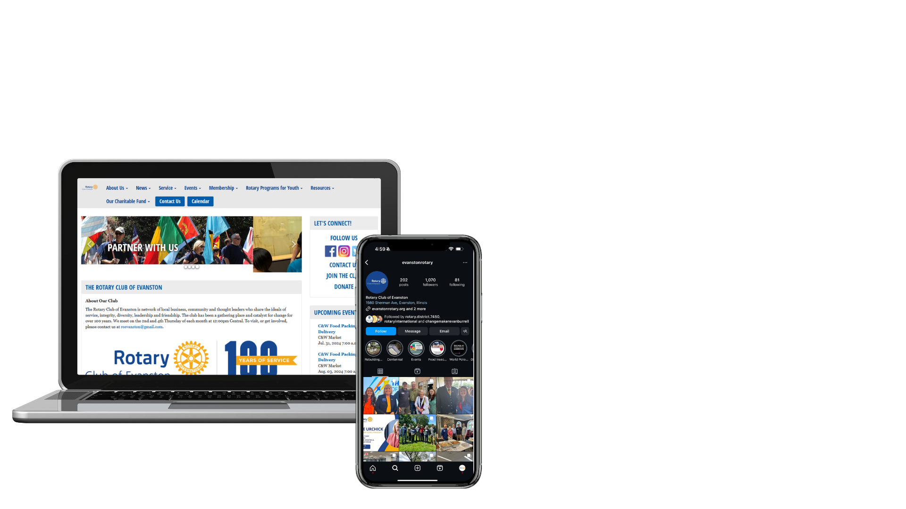
EXPAND YOUR DIGITAL PRESENCE
Website & social media: Sharing with purpose
Ways to achieve a strong digital presence:
Be consistent with your brand
Focus on your audience
Use social media to drive readers to your website or vice versa
Rotary Leadership Colors
Royal Blue
R23,G69,B143
Azure
R0,G93,B170
Sky Blue
R1,G180,B231
Gold
R247,G168,B27
Secondary Colors
Cranberry
R217,G27, B92
Turquoise
R0,G153,B153
Violet
R135,G33,B117
Orange
R255,G118,B0
Notes:
Website – Social Media - Website
Sharing with Purpose
Ways to achieve a strong digital presence
Be consistent with your brand
Rotary District - Rotary Club
Focus on your audience.
Target your demographic – Rotary – Rotaract - Interact
Make use of social media to drive readers to your website
Write stories – Upload to your Rotary Website – Share to Facebook, Instagram or Twitter
(Limit Social Media to what your group can handle)

Slide 24

EXPAND YOUR DIGITAL PRESENCE
Content that connects
Create video content that tells a story and Illustrates what someone can expect from your club or district’s activities and membership
Protip: Use CapCut to edit video and generate auto captions
Find many tutorials on YouTube

Slide 25

EXPAND YOUR DIGITAL PRESENCE
Advertising for social media
Advertise Rotary district and club events and in-the-moment
Events, fundraisers, service projects
Photographs and videos
People of Action in action
Make use of social media
Share to social media in the moment—live streaming
Rotary Leadership Colors
Royal Blue
R23,G69,B143
Azure
R0,G93,B170
Sky Blue
R1,G180,B231
Gold
R247,G168,B27
Secondary Colors
Cranberry
R217,G27, B92
Turquoise
R0,G153,B153
Violet
R135,G33,B117
Orange
R255,G118,B0

Slide 26





EXPAND YOUR DIGITAL PRESENCE
The Public
What they say about you
How they engage with you
Creating curiosity increases membership
Rotary Leadership Colors
Royal Blue
R23,G69,B143
Azure
R0,G93,B170
Sky Blue
R1,G180,B231
Gold
R247,G168,B27
Secondary Colors
Cranberry
R217,G27, B92
Turquoise
R0,G153,B153
Violet
R135,G33,B117
Orange
R255,G118,B0

Slide 27
CALL TO ACTION
1
Visit and use the Learning Center and Brand Center
Identify and partner with others in your community for broader visibility and impact
Expand your digital presence: It's more than relying on a single platform
2
3

Slide 28
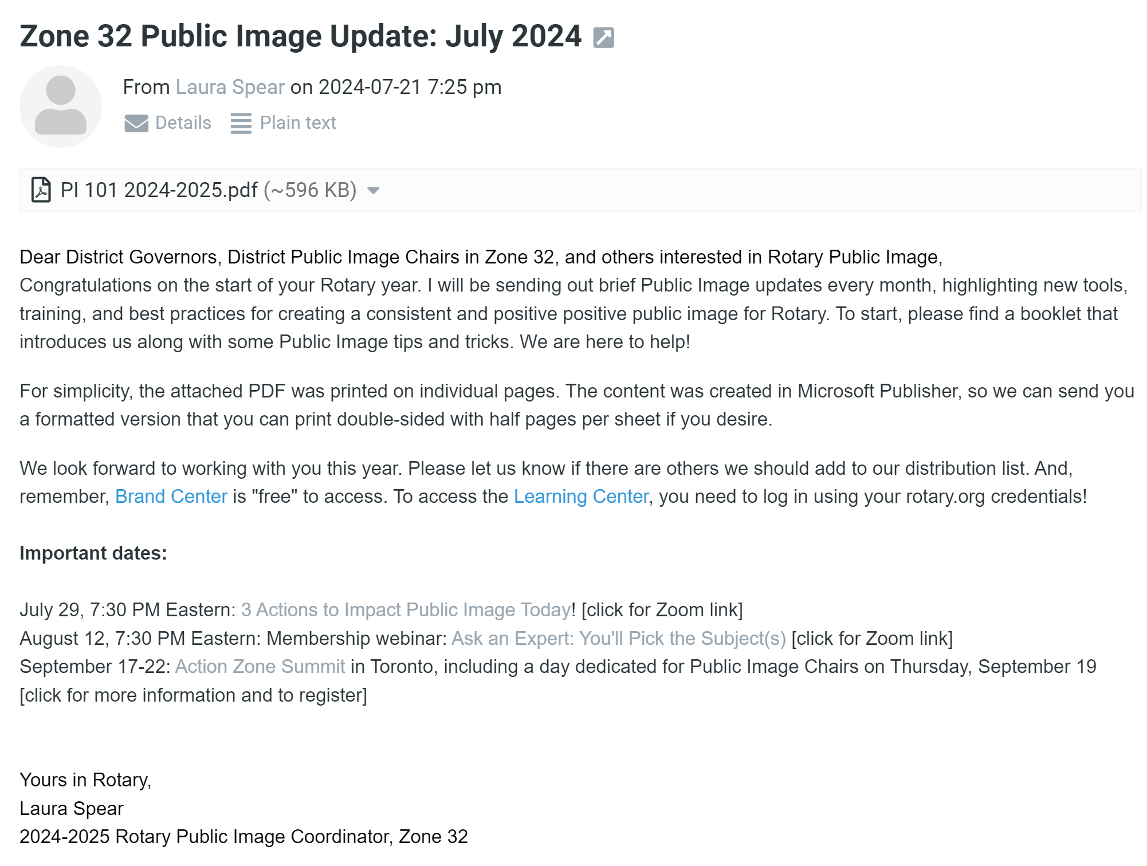
Put your name, email, and district in the Chat to get on the distribution list!

Slide 29

QUESTIONS

